Slide 1
Getting Started in Python
© 2025 Virginia Polytechnic Institute and State University. All rights reserved.

Slide 2
Anaconda
In this course, we will download, install, and use the Anaconda distribution of Python and Jupyter Lab
Anaconda includes:
an installation of Python (version 3.12 as of right now),
most commonly Python packages (numpy, pandas, scikit-learn, etc). See this link for package management: https://docs.anaconda.com/navigator/tutorials/manage-packages/
Jupyter Notebook / Jupyter Lab
commonly used Python IDEs (i.e. PyCharm, Spyder, VScode, etc.)
a Python Console
and more!

Slide 3
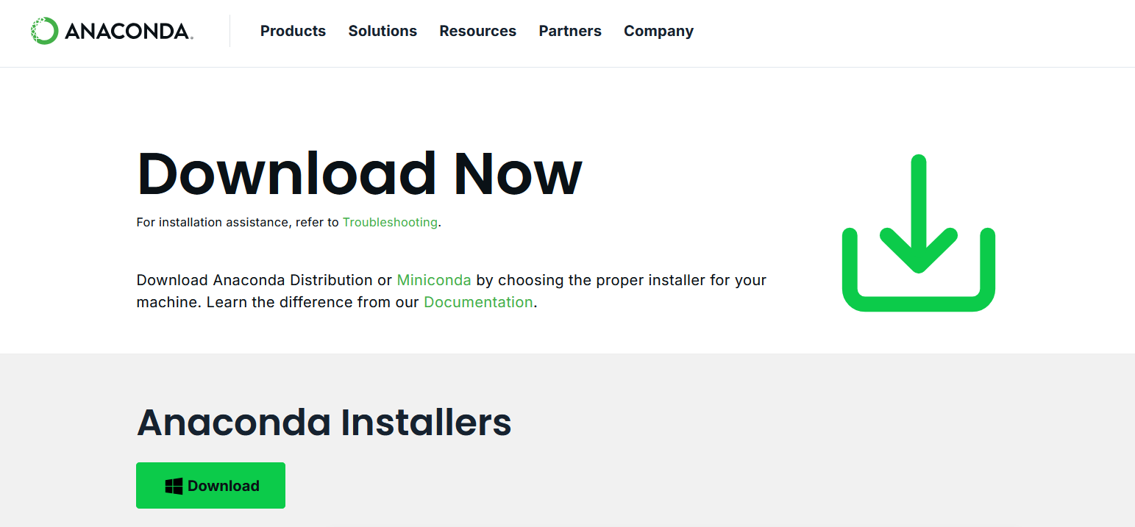
Python Installation: Step 1
Go to https://www.anaconda.com/download/success

Slide 4
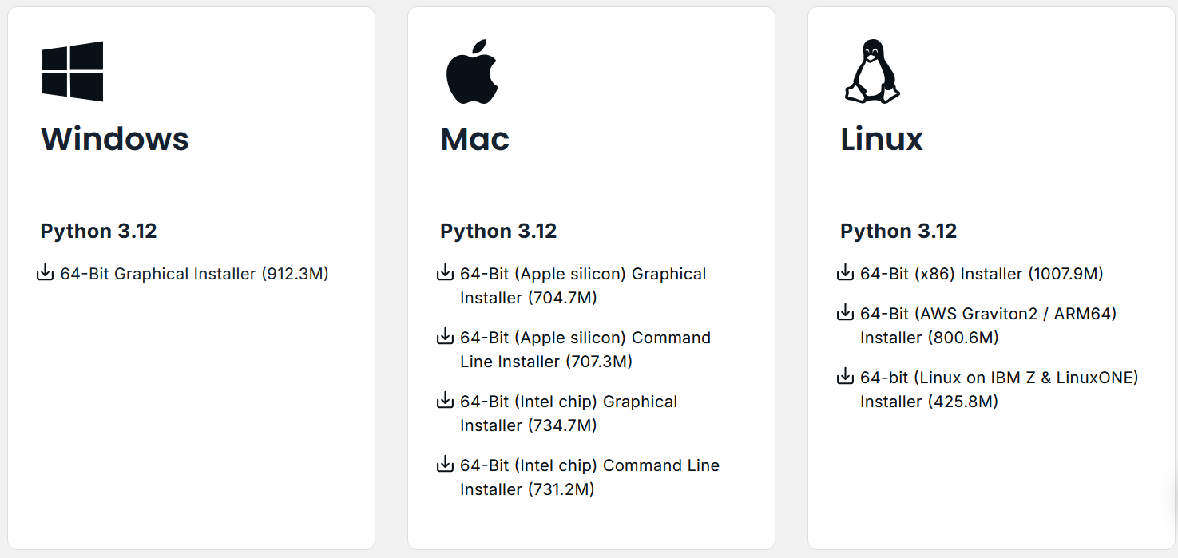
Python Installation: Step 2
Download the correct Anaconda installer based on your operating system.
Notes:
NEED TO BE ABLE TO EXPLAIN WHICH THEY SHOULD CHOOSE AND DIFFERENCES IN MAC OPTIONS

Slide 5
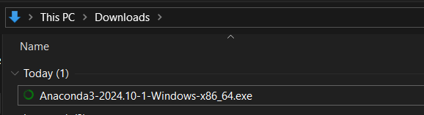
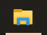
Python Installation: Step 3
Open the installer from your Downloads (for example, on Windows this is done by double clicking the file named Anaconda3-2024.10-1-Windows-x86_64.exe).
On Windows: In your Files, go to your Downloads and identify the correct .exe file

Slide 6
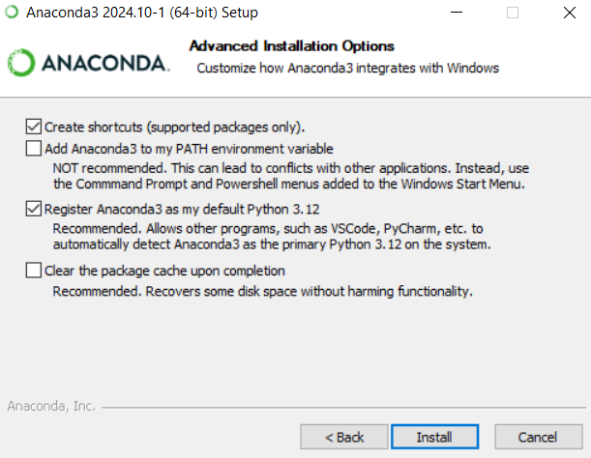
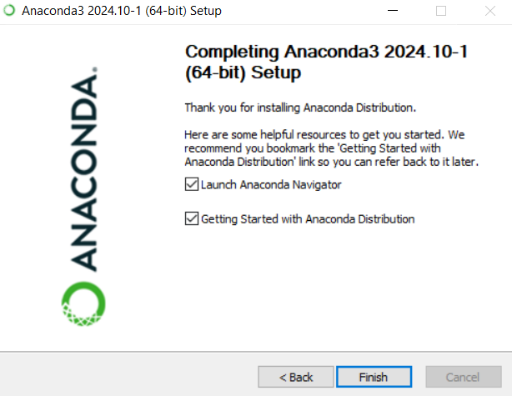
Python Installation: Step 4
Follow the installation prompts, using the default settings (meaning do not change any settings, just continue to click Next >). When prompted, click Install. Installation may take a few minutes.
Final window once installation is complete:
Clicking Finish will automatically launch Anaconda Navigator (assuming the above boxes are checked).

Slide 7
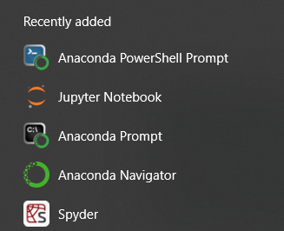
Python Installation: Step 5
Once installed, open Anaconda Navigator. It may have opened automatically in the previous step.
Anaconda Navigator Icon should look like this:
Automatically installed automatically with Anaconda:

Slide 8
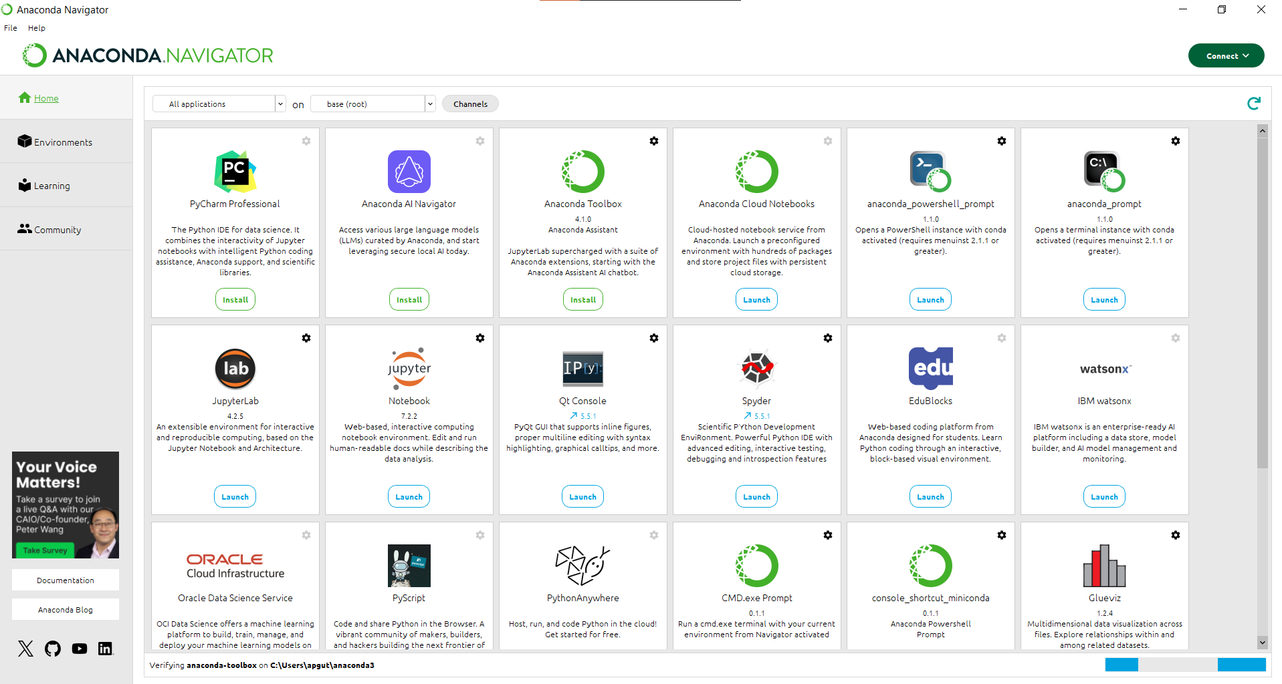
Anaconda Navigator
Once Anaconda Navigator is open, you can close all pop-up boxed. Then it should look like this:
We’ll launch JupyterLab from here!

Slide 9
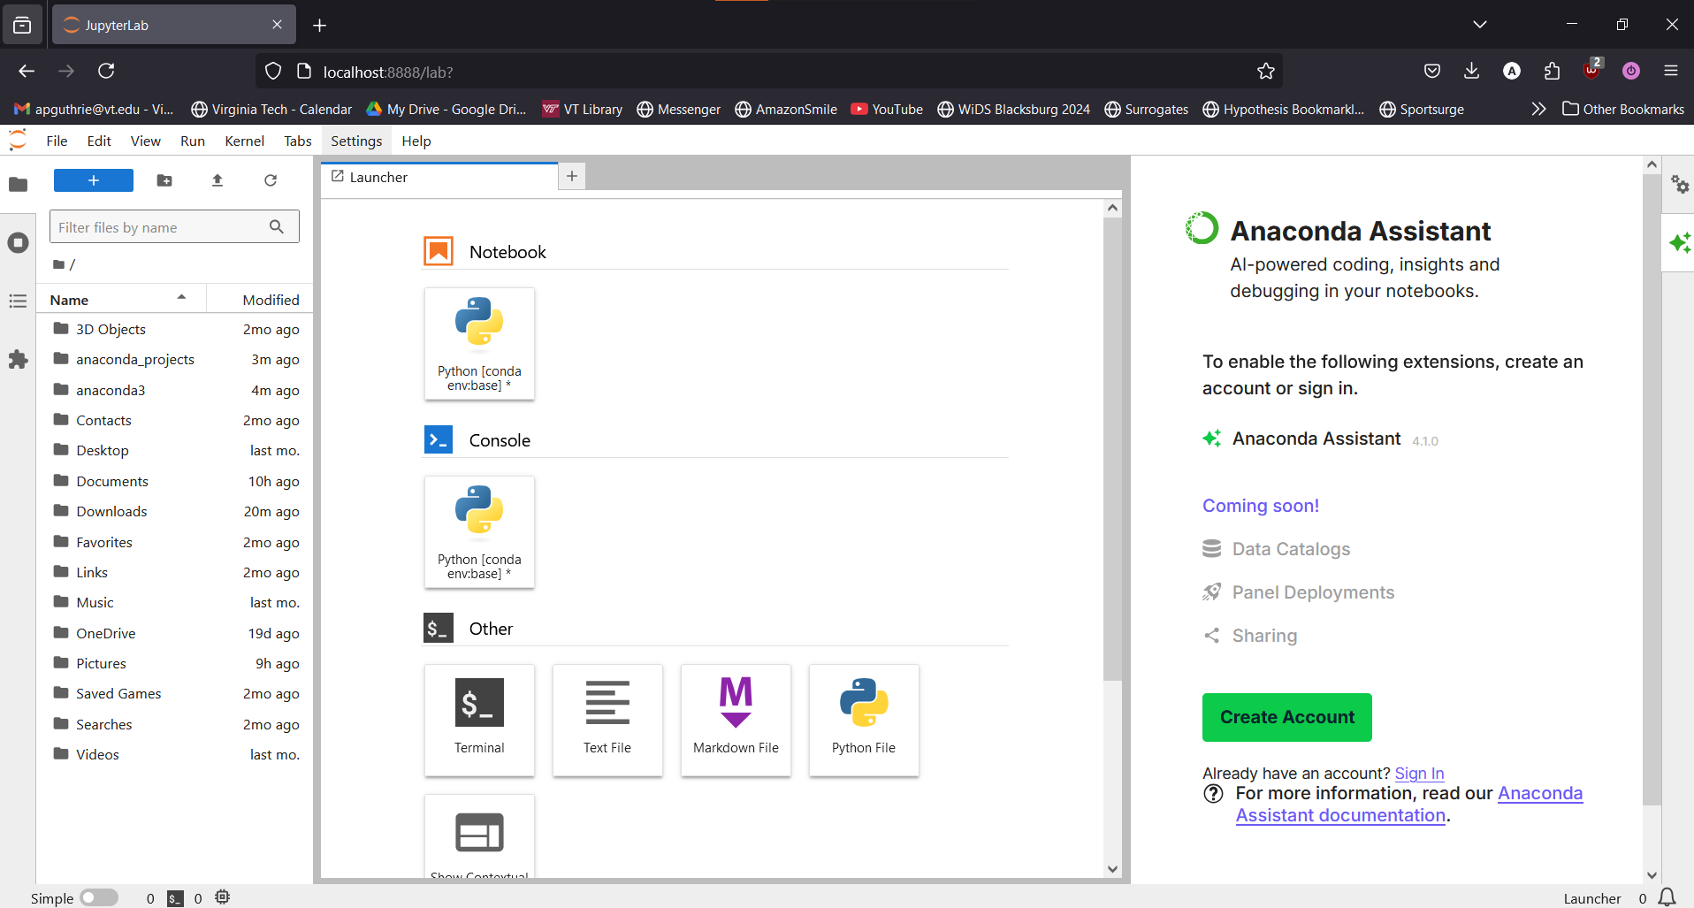
JupyterLab
Click Launch under JupyterLab, which will bring up the following window in your browser
From here we can open our first Jupyter Notebook and start running Python code!
Make sure that you’ve downloaded the code files from Canvas.
Then navigate to where you put the code files on your computer using the left side panel (your Downloads folder if you have not moved them elsewhere).

Slide 10
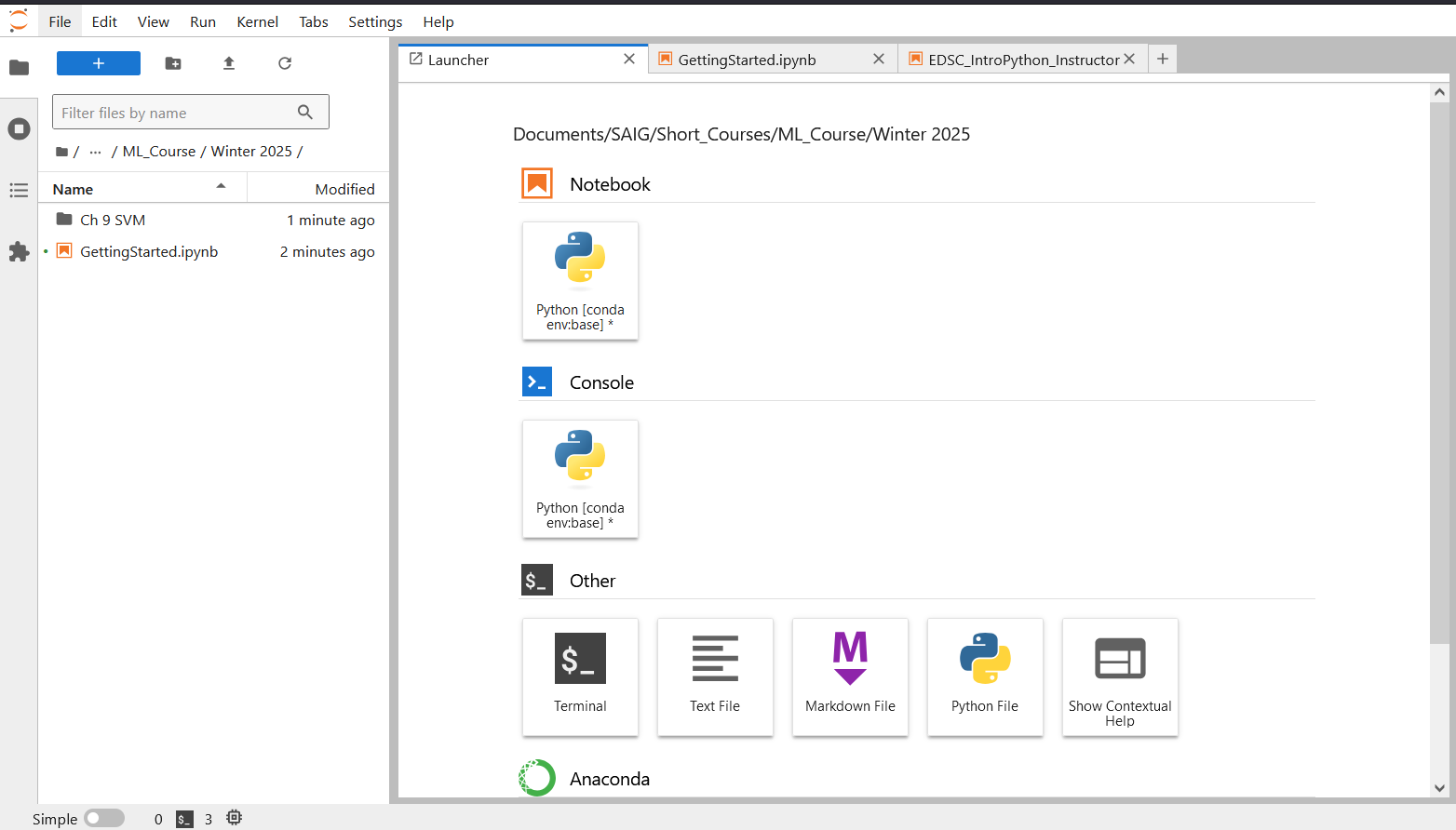
Open the GettingStarted.ipynb Notebook
Navigate to where you saved this file on your computer & double click GettingStarted.ipynb

Slide 11
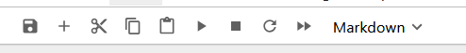
Running Code in a Jupyter NoteBook
Throughout this course, we’re going to work with Jupyter Notebooks instead of Python Scripts
This allows us to run code interactively and immediately see the results.
All code in a Jupyter Notebook must be written and run from inside a code cell which look like the following:
To run the code, click the grey code cell and then the triangle in the bar at the top of the window…
…or hit Ctrl+Enter

Slide 12
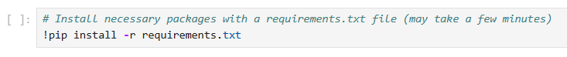
Installing Necessary Packages
While most common Python package are automatically installed with Anaconda, we need the ISLP package throughout this course to access datasets. We will need a few other packages as well.
IMPORTANT STEP: We need to install the necessary packages in our requirements.txt file
To do so, run the following code cell in the Getting Started Notebook:

Slide 13
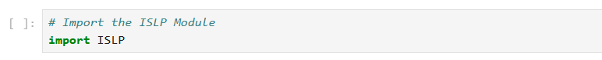
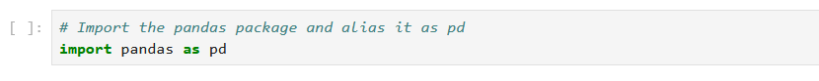
Importing Packages
Before we can use an installed package, we also have to import it. To import the ISLP package, run the following code cell:
We will also need to import other common data science packages like pandas.
It is common to alias this package with the name pd. This is to streamline code so we can type pd instead of pandas whenever we use the package.
To import pandas with the alias pd, run the following code cell:

Slide 14
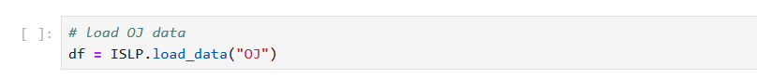
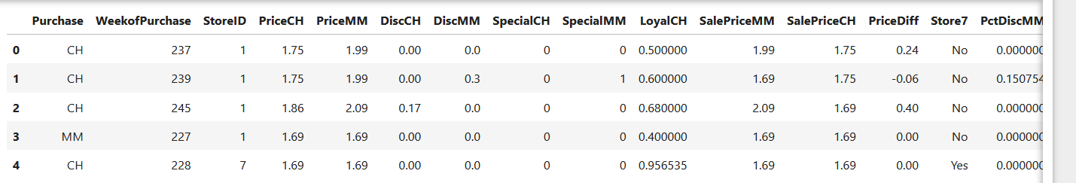
Reading in Data from the ISLP Package
To read in data from the ISLP package, we’ll need to use data_import()
The following code chunk imports the OJ package which we’ll use later in the course:
To see the first few rows of the data, run the following code chunk:

Slide 15
Importing Data from a CSV File
In practice, your data will likely not come from Python packages.
Instead, you'll want to read in data from an separate file, like a .csv file.
We will not cover reading in data files in this course, see the following LinkedIn Learning video for more information:
https://www.linkedin.com/learning/pandas-essential-training/using-read-csv?resume=false&u=57888345

